Slide 1
Utilizing Machine Learning Model in Forecasting Pollutant Releases for 2023
Abi Afolabi
Abiola Bakare
Enkeshie Parris
Ruth Olasupo
10th December 2024

Slide 2
Problem Statement
Depending on provincial population trends, predict the amount of ammonia, nitrate ions and phosphorous released to water from wastewater treatment plants in 2023 (data).

Slide 3
Defining Pollutant DataFrames
3 dataframes for 3 separate models: Phosphorus, Ammonia and Nitrate Ion

Slide 4

Feature Engineering / Preprocessing
New Features
Data Merging
Splitting
Encoding
Normalization
Total Releases to Water
Region
Population
Pollutant
Split year = 2018
One-Hot
Target
StandardScaler
Notes:
New Features:
Total Release to Water - summed up 3 release to water bodies columns: Direct Discharges, Leaks and Spill to create a new column, 'Total_Release_to_Water'
Region - we applied K-means clustering to the latitude and longitude columns. This divided the data into 5 clusters (regions) based on the geographical coordinates and assigned the cluster label to a new column, 'Region', for both datasets.
Data Merging:
Splitting: We split the ammonia dataset into training and testing sets using the year 2018 as the dividing point, where data from 2018 and earlier goes into the training set, and later data goes into the testing set.
Encoding: using a function, we scaled numerical features using StandardScaler and encoded categorical features using either one-hot encoding or target encoding as applicable
Normalization:

Slide 5

Feature Selection
P-value
Pearson Correlation
Backward Elimination technique
Reducing of highly correlated features to 1

Slide 6
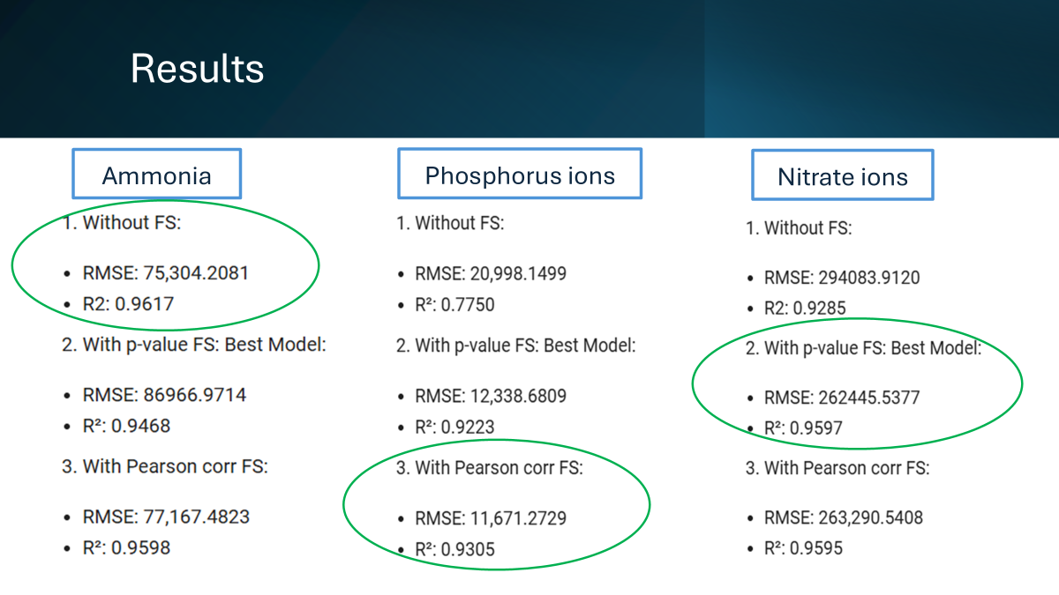
Cross validation

Slide 7
Model Building
Lag features of numerical features
ML model - Random Forest (best performing model
Feature Selection

Slide 8
Features for Forecasting
Reporting Year/Année
NPRI ID/No INRIP
Number of Employees
Company Name/Dénomination sociale de l'entreprise
Facility Name/Installation
NAICS/Code SCIAN
NAICS Title/Titre Code SCIAN
PROVINCE
City
Latitude
Longitude
CAS Number/No CAS
Estimation Method/Méthode d'estimation
CAS Number/No CAS
Estimation Method/Méthode d'estimation
Release to Air (Fugitive)
Release to Air (Other Non-Point)
Release to Air (Road Dust)
Release to Air (Spills)
Release to Air (Stack/Point)
Release to Air (Storage/Handling)
Releases to Land (Leaks)
Releases to Land (Other)
Releases to Land (Spills)
Sum of Release to All Media (<1 tonne)
Population
Total Release to Water
Region

Slide 9
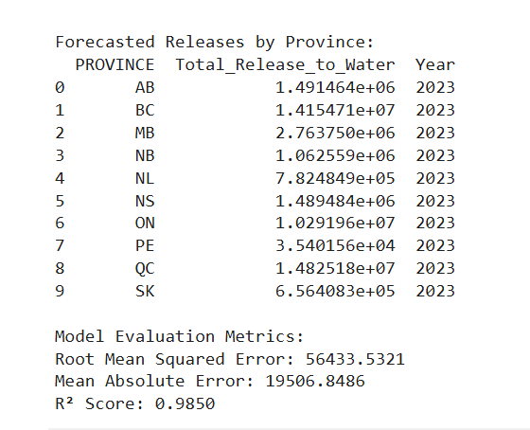
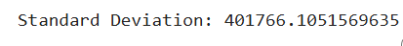
Ammonia Forecast

Slide 10
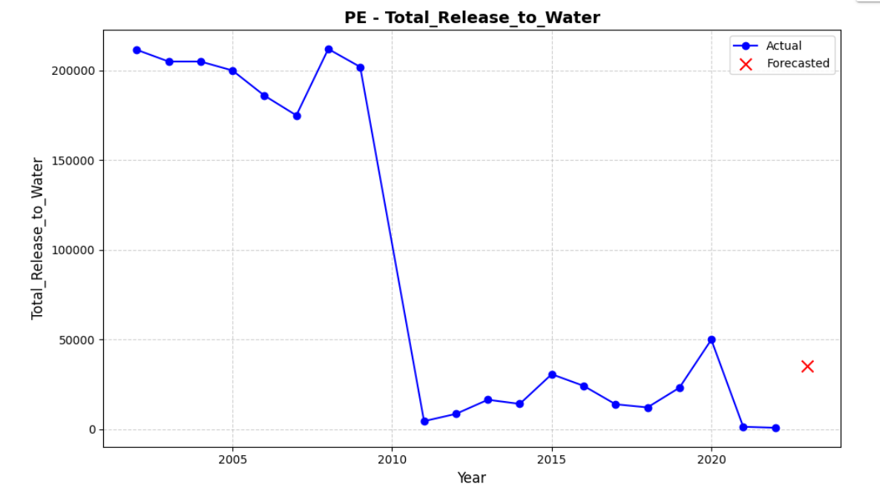
Ammonia Forecast

Slide 11
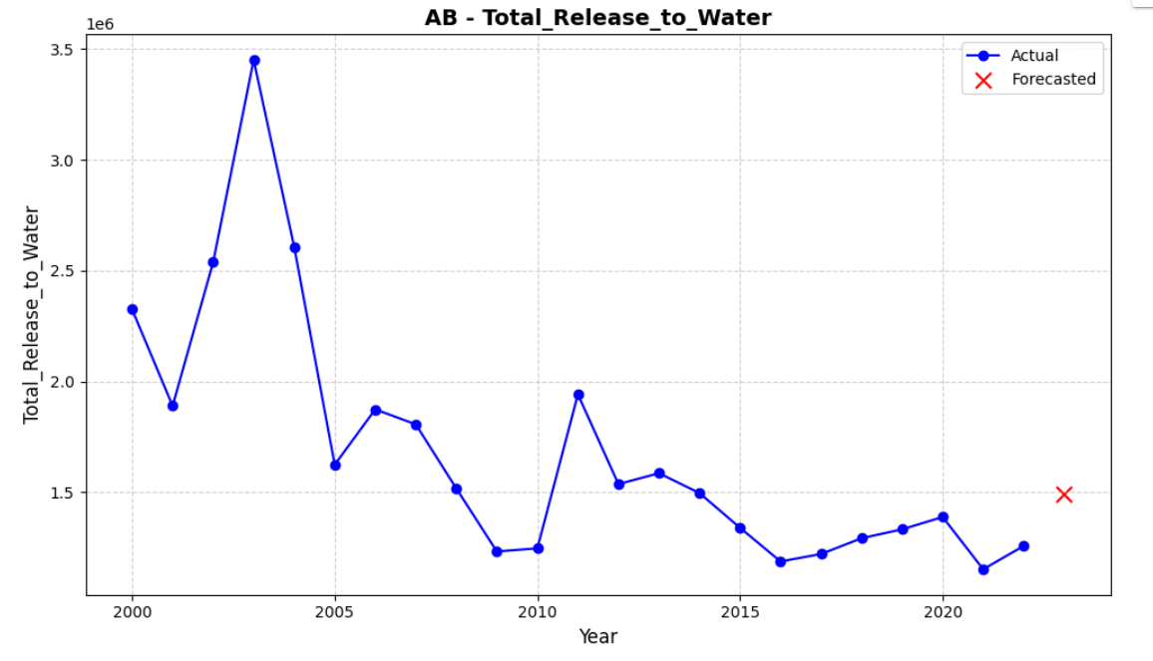
Ammonia Forecast

Slide 12
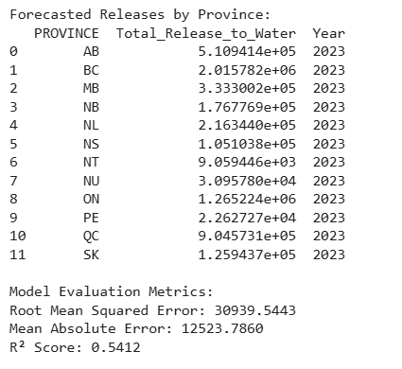
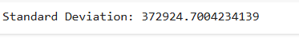
Phosphorus Forecast

Slide 13
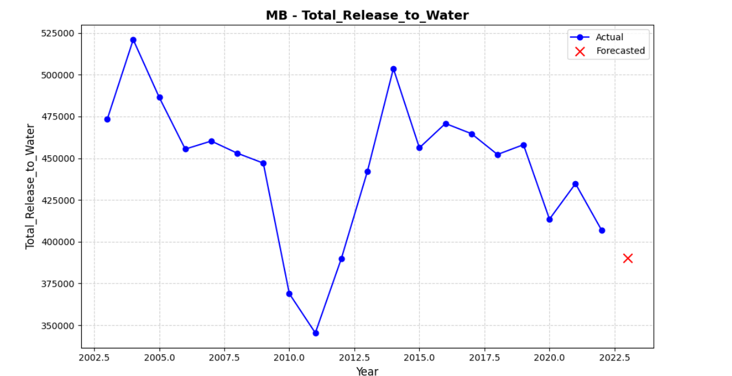

Slide 14
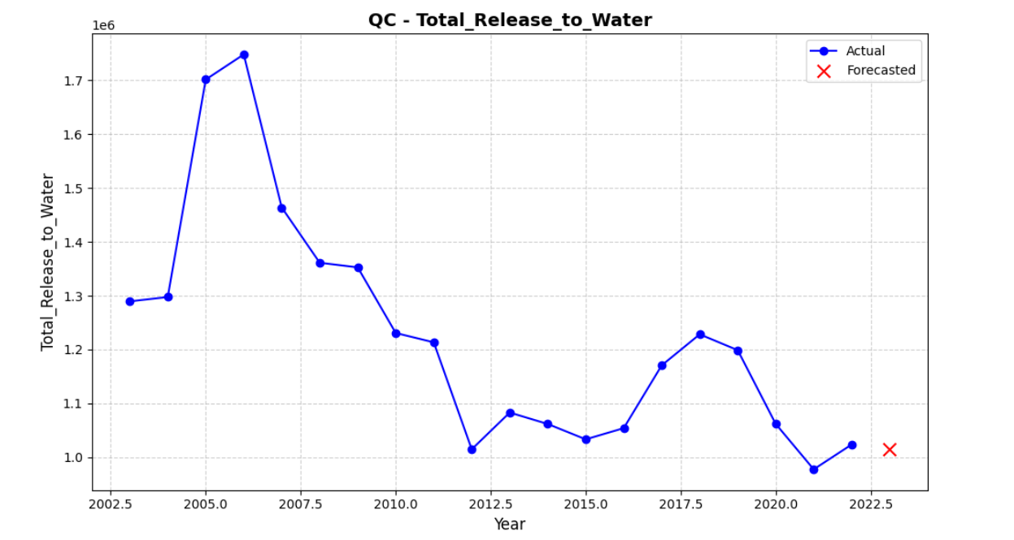

Slide 15
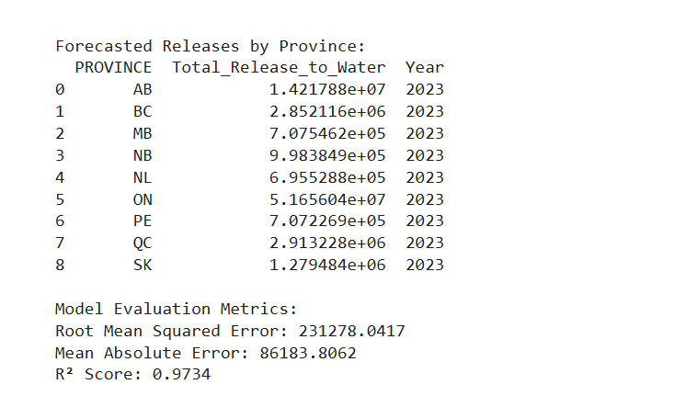
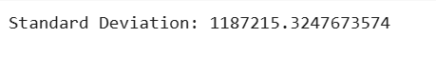
Nitrate Forecast

Slide 16
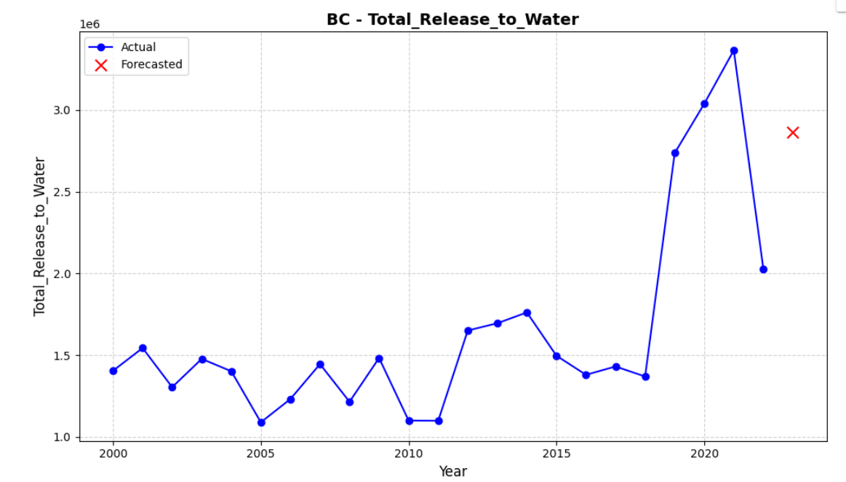

Slide 17
